Slide 1
Image Descriptions
David Kwon-Han Lam
CKME 136

Slide 2
Intro
The image descriptions data set can be obtained from the website https://www.figure-eight.com/data-for-everyone/.
This dataset consists of a set of images, matched words, and a confidence score for each matched pair. Contributors were shown pictures and words and ask to determine whether if the two pairs are relevant to each other. If they match, they are given a score. The confidence score shows how likely the contributor matched the image with the word.

Slide 3
Intro Context
My goal from using this data set is to create a classification algorithm that would be able to predict the best word and image combination. By perfecting the algorithm, we can successfully predict what most of the general public uses to describe images.

Slide 4
Literature Review
CIDEr: Consensus-Based Image Description Evaluation
Framing Image Description as a Ranking Task: Data, Models and Evaluation Metrics (Extended Abstract)
Simple Image Description Generator Via A Linear Phrase-Based Model
Comparing Automatic Evaluation Measures for Image Description

Slide 5
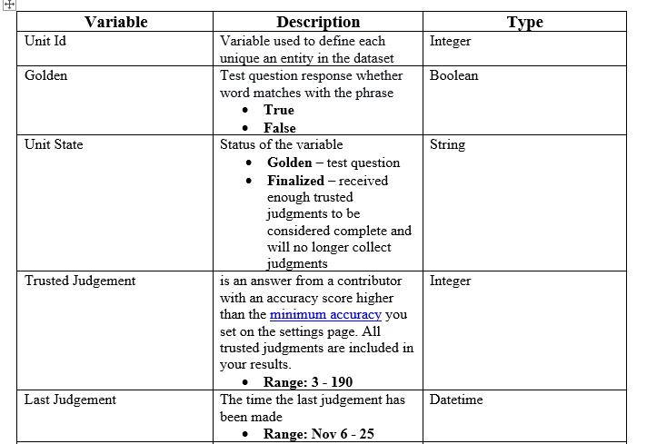
Data Set

Slide 6
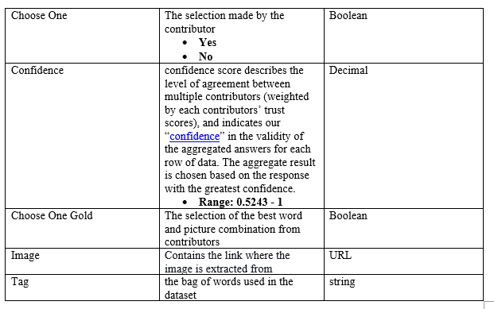
Data Set

Slide 7
Approach
Data Collection
Data Exploration
Feature Selection
Build Models
Summary and Conclusion

Slide 8
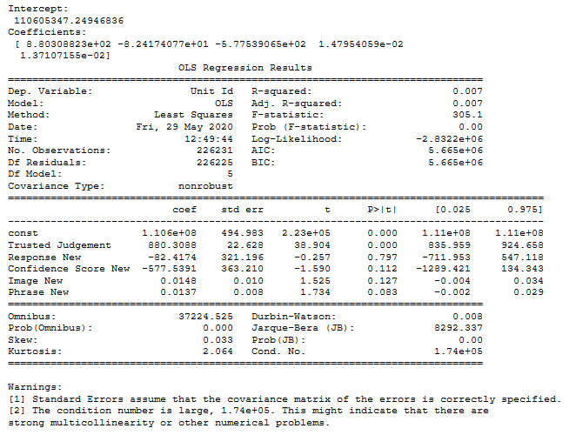
Multi-Linear Regression Model

Slide 9
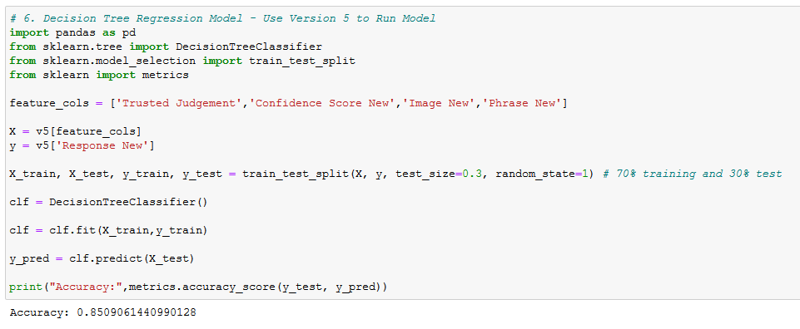
Decision Tree Model

Slide 10
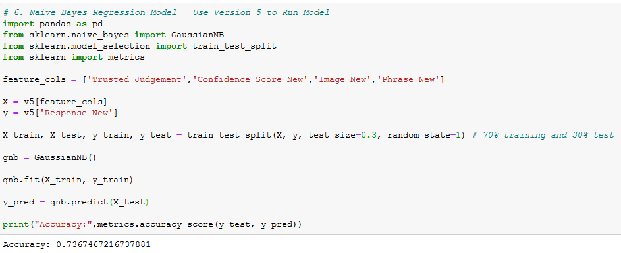
Naïve Bayes Model

Slide 11
Conclusion

Slide 12
Work Cited
Vedantam, R., Lawrence Zitnick, C., & Parikh, D. (2015). Cider: Consensus-based image description evaluation. In Proceedings of the IEEE conference on computer vision and pattern recognition (pp. 4566-4575).
Hodosh, M., Young, P., & Hockenmaier, J. (2013). Framing image description as a ranking task: Data, models, and evaluation metrics. Journal of Artificial Intelligence Research, 47, 853-899.
Lebret, R., Pinheiro, P. O., & Collobert, R. (2014). Simple image description generator via a linear phrase-based approach. arXiv preprint arXiv:1412.8419.
Elliott, D., & Keller, F. (2014, June). Comparing automatic evaluation measures for image description. In Proceedings of the 52nd Annual Meeting of the Association for Computational Linguistics (Volume 2: Short Papers) (pp. 452-457).
“Data For Everyone.” Figure Eight, www.figure-eight.com/data-for-everyone/.
“Glossary of Terms.” Figure Eight Success Center, success.figure-eight.com/hc/en-us/articles/202703305-Glossary-of-Terms.
“Image Descriptions - Dataset by Crowdflower.” Data.world, 21 Nov. 2016, data.world/crowdflower/image-descriptions/workspace/data-dictionary.
Naive Bayes classification using scikit-learn. (n.d.). DataCamp Community. https://www.datacamp.com/community/tutorials/naive-bayes-scikit-learn

